Slide 1
Requirements Validation – II
LECTURE # 17

Slide 2
Review Checklists - 1
Understandability
  Can readers of the document understand what the requirements mean?
Redundancy
  Is information unnecessarily repeated in the requirements document?

Slide 3
Review Checklists - 2
Completeness
  Does the checker know of any missing requirements or is there any information missing from individual requirement descriptions?

Slide 4
Review Checklists - 3
Ambiguity
  Are the requirements expressed using terms which are clearly defined? Could readers from different backgrounds make different interpretations of the requirements?
Consistency
  Do the descriptions of different requirements include contradictions? Are there contradictions between individual requirements and overall system requirements?

Slide 5
Review Checklists - 4
Organization
  Is the document structured in a sensible way? Are the descriptions of requirements organized so that related requirements are grouped?

Slide 6
Review Checklists - 5
Conformance to standards
  Does the requirements document and individual requirements conform to defined standards? Are departures from the standards, justified?
Traceability
  Are requirements unambiguously identified, include links to related requirements and to the reasons why these requirements have been included?

Slide 7
Checklist Questions & Quality Attributes - 1
Is each requirement uniquely identified?
  Traceability, conformance to standards
Are specialized terms defined in the glossary
  Understandability
Does a requirement stand on its own or do you have to examine other requirements to understand what it means?
  Understandability, completeness

Slide 8
Checklist Questions & Quality Attributes - 2
Do individual requirements use the terms consistently
  Ambiguity
Is the same service requested in different requirements? Are there any contradictions in these requests?
  Consistency, redundancy

Slide 9
Checklist Questions & Quality Attributes - 3
If a requirement makes reference to some other facilities, are these described elsewhere in the document?
  Completeness
Are related requirements grouped together? If not, do they refer to each other?
  Organization, traceability

Slide 10
Prototyping
Prototypes for requirements validation demonstrate the requirements and help stakeholders discover problems
Validation prototypes should be complete, reasonably efficient and robust. It should be possible to use them in the same way as the required system
User documentation and training should be provided

Slide 11
Prototyping for Validation
Choose
prototype
testers
Develop
test
scenarios
Execute
scenarios
Document
problems
Document and extend prototype system

Slide 12
Prototyping Activities - 1
Choose prototype testers
  The best testers are users who are fairly experienced and who are open-minded about the use of new systems. End-users who do different jobs should be involved so that different areas of system functionality will be covered

Slide 13
Prototyping Activities - 2
Develop test scenarios
  Careful planning is required to draw up a set of test scenarios which provide broad coverage of the requirements. End-users shouldn’t just play around with the system as this may never exercise critical system features

Slide 14
Prototyping Activities - 3
Execute scenarios
  The users of the system work, usually on their own, to try the system by executing the planned scenarios
Document problems
  Its usually best to define some kind of electronic or paper problem report form which users fill in when they encounter a problem

Slide 15
User Manual Development - 1
Writing a user manual from the requirements forces a detailed requirements analysis and thus can reveal problems with the document

Slide 16
User Manual Development - 2
Information in the user manual
  Description of the functionality and how it is implemented
  Which parts of the system have not been implemented
  How to get out of trouble
  How to install and get started with the system

Slide 17
System Models
For some projects, system models may be developed based on the agreed set of requirements
These models may be data-flow models of the system’s functionality, object models, event models, entity-relation models

Slide 18
Model Validation
Validation of system models is an essential part of the validation process
Some checking is possible with automated tools
Paraphrasing the model is an effective checking technique

Slide 19
Objectives of Model Validation
To demonstrate that each model is self-consistent
If there are several models of the system, to demonstrate that these are internally and externally consistent
To demonstrate that the models accurately reflect the real requirements of system stakeholders. This is very difficult

Slide 20
Data-flow Diagram for Issue
User details
Library card
Check
user
User status
Requested item
Check
item
Item status
Issued item
Issue
item
Update details

Slide 21
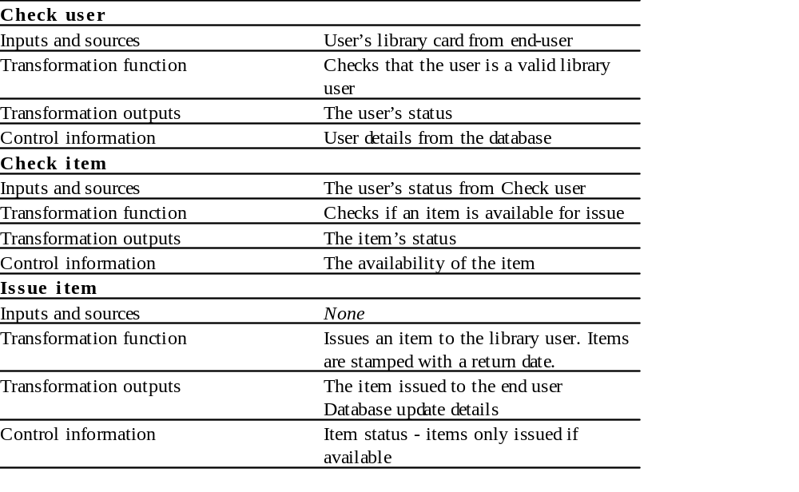
Paraphrased Description

Slide 22
Requirements Testing - 1
Each requirement should be testable i.e., it should be possible to define tests to check whether or not that requirement has been met
Inventing requirements tests is an effective validation technique as missing or ambiguous information in the requirements description may make it difficult to formulate tests

Slide 23
Requirements Testing - 2
Each functional requirement should have an associated test

Slide 24
Test Case Definition - 1
What usage scenario might be used to check the requirement?
Does the requirement, on its own, include enough information to allow a test to be defined?

Slide 25
Test Case Definition - 2
Is it possible to test the requirement using a single test or are multiple test cases required?
Could the requirement be re-stated to make the test cases more obvious?

Slide 26
Hard-to-Test Requirements
System requirements
Exclusive requirements
Some non-functional requirements

Slide 27
System requirements
Requirements which apply to the system as a whole. In general, these are the most difficult requirements to validate irrespective of the method used as they may be influenced by any of the functional requirements. Tests, which are not executed, cannot test for non-functional system-wide characteristics such as usability

Slide 28
Exclusive Requirements
These are requirements which exclude specific behavior. For example, a requirement may state that system failures must never corrupt the system database. It is not possible to test such a requirement exhaustively

Slide 29
Some Non-Functional Requirements
Some non-functional requirements, such as reliability requirements, can only be tested with a large test set. Designing this test set does not help with requirements validation

